Slide 1

COMP 90049
Knowledge Technologies
Week 12
我们毕业啦
其实是答辩的标题地方
Tutor
Ang Li

Slide 2
Name: Ang Li
E-mail: angl4@student.unimelb.edu.au
Contact information
Research topic: computer vision

Slide 3
Summery
Work through this week’s exercise
Notes:
Secure File Transfer Protocol
Secure Shell

Slide 4
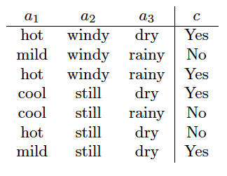
Exercise 1.
Construct all of the 1-itemsets and calculate their confidences and supports using Association Rules.

Slide 5
Itemset
A collection of one or more items
k-itemset: An itemset that contains k items
Confidence
Measures how often items in A appear in transactions that contain B.
Support
Fraction of transactions that contain both A and B

Slide 6
The 1-itemsets are all of the values each of the attributes can take. Counting the“class”values，there are 9 such itemsets: {hot}, {mild}, {cool}, {windy}, {still}, {dry}, {rainy}, {Yes}, and {No}.

Slide 7

When we consider support and confidence, it's typically over an association rule, not an itemset. There are two association rules that we can generate for a given 1-itemset, say {hot}: one with the item in the antecedent and one with the item in the consequent:

Slide 8
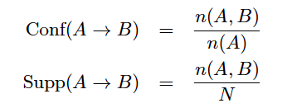

Recall the formulas for confidence and support, for N instances in total:
For rules of type (1) (with an empty consequent), the confidence will be 1 (because n (A, *) = n (A)). For rules of type (2) (with an empty antecedent), the confidence will be equal to the support (because n (*) = N ). Hence, the only interesting value we need to calculate at this point is support:

Slide 9
Exercise 3. What occurs in the training phase of a neural network? What occurs in the test phase?

Slide 10
In the training phase, we attempt to determine the weights on the branches in the network, so as to minimize the calculated error function between our predicted values at the output node(s), and the actual (true) values, across the training data.
Typically we use some gradient descent method over the partial derivatives of the error function (with respect to the various weights) to estimate the optimal weights iteratively.

Slide 11
Once we have our weights, we make predictions for a test instances by:
Multiplying the input node values by the corresponding weights to find the pre-activation values of the hidden nodes
Applying the activation function at the hidden nodes;
Iterating through each hidden layer;
Finally, applying the activation function at the output node(s) to observe the predicted value(s)

Slide 12
Thanks!

